Slide 1
Osher Lifelong Learning Institute, Summer 2024
Contemporary Economic Policy
Dartmouth College
Host: Jon Haveman, Ph.D.
National Economic Education Delegation

Slide 2
National Economic Education Delegation
Vision
  One day, the public discussion of policy issues will be grounded in an accurate perception of the underlying economic principles and data.
Mission
  NEED unites the skills and knowledge of a vast network of professional economists to promote understanding of the economics of policy issues in the United States.
NEED Presentations
  Are nonpartisan and intended to reflect the consensus of the economics profession.

Slide 3
Who Are We?
Honorary Board: 54 members
  2 Fed Chairs: Janet Yellen, Ben Bernanke
  6 Chairs Council of Economic Advisers
    Furman (D), Rosen (R), Bernanke (R), Yellen (D), Tyson (D), Goolsbee (D)
  3 Nobel Prize Winners
    Akerlof, Smith, Maskin
Delegates: 652+ members
  At all levels of academia and some in government service
  All have a Ph.D. in economics
  Crowdsource slide decks
  Give presentations
Global Partners: 48 Ph.D. Economists
  Aid in slide deck development

Slide 4


Where Are We?

Slide 5
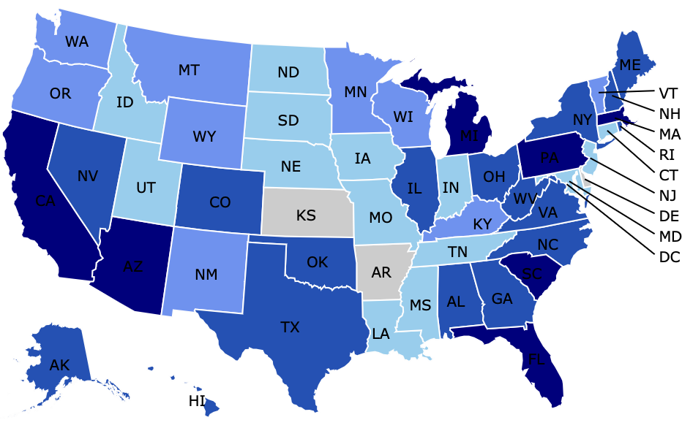
Where Have we Given Talks?

Slide 6
Available NEED Topics Include:
US Economy
Healthcare Economics
Climate Change
Economic Inequality
Economic Mobility
Trade and Globalization
Minimum Wages
Immigration Economics
Housing Policy
Federal Budgets
Federal Debt
Black-White Wealth Gap
Autonomous Vehicles
US Social Policy

Slide 7
Course Outline
Contemporary Economic Policy
  Week 1 (6/24): Economic Update (Geoffrey Woglom, Amherst College)
  Week 2 (7/01): International Institutions (Alan Deardorff, U of Michigan)
  Week 3 (7/08): (Emily Blanchard, Tuck School, Dartmouth)
  Week 4 (7/15): Climate Change Economics (Sarah Jacobson, Williams College)
  Week 5 (7/22): Federal Debt and Deficits (Joseph Carolan, Oakland University)
  Week 6 (7/29): Autonomous Vehicles (Arkadiusz Mironko)

Slide 8

Main Economic Institutions
Notes:
https://sbhshgovapmacro.wordpress.com/2011/06/02/international-institutions/

Slide 9
Globalization at a Crossroads
New Talk!

Slide 10
How Economists Decide How Much to Fight
Climate Change: Cost Benefit Analysis
Abating greenhouse gas emissions is costly…
… but without action, climate change damages are even more costly.
Goal is not zero emissions, but efficient level that achieves a balance.
Expected costs of reducing emissions
Expected damages from allowing climate change

Slide 11
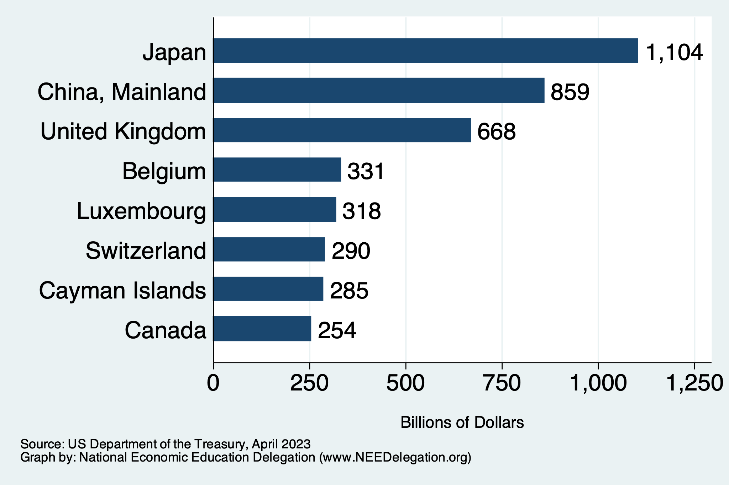
Who Holds US Debt?
https://ticdata.treasury.gov/Publish/mfh.txt

Slide 12
Growth Path
McKinsey & Company
Notes:
This is the growth path according to McKinsey
I believe that the growth path will vary significantly depending on geography
Kansas – very slow
Bay Area – very fast
But I think that they agree with me on where we are headed
Primary means of transport for both people and goods

Slide 13
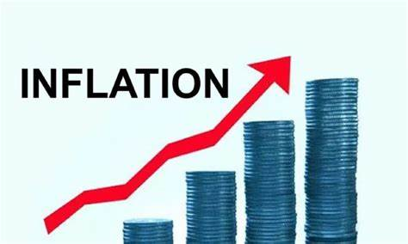
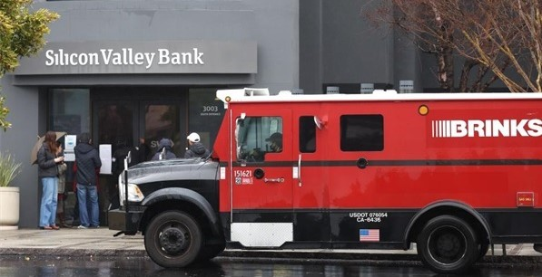
US Economy: Update
Geoffrey Woglom,
Professor of Economics
Amherst College, emeritus
June 24, 2024

Slide 14
Credits and Disclaimer
This slide deck was authored by:
  Jon D. Haveman, NEED
  Scott Baier, Clemson University
  Geoffrey Woglom, Amherst College (Emeritus)
  Brian Dombeck, Lewis & Clark College
  Doris Geide-Stevenson, Weber State
Disclaimer
  NEED presentations are designed to be nonpartisan.
  It is, however, inevitable that the presenter will be asked for and will provide their own views.
  Such views are those of the presenter and not necessarily those of the National Economic Education Delegation (NEED).

Slide 15
Submitting Questions
Submit questions in the chat or by raising your digital hand.
  I will try to handle them as they come up.
Five minute break towards the middle of the talk.
We will do a verbal Q&A once the material has been presented.
Slides will be available from the NEED website tonight (https://needelegation.org/delivered_presentations.php).
My macro site: https://sites.google.com/view/macro-current-issues/home

Slide 16
Outline for the Talk
Summary of the state of the macroeconomy.
The Effect of M&F policies on the recovery.
Describe an unprecedented monetary policy achievement that may be unfolding.
Major challenges and uncertainties going forward

Slide 17
Gross Domestic Product: 2024Q1 = $28.3 tr
$29.1
Less Imports
-$3.9
Plus Exports
+$3.1
Equals GDP
$28.3

Slide 18
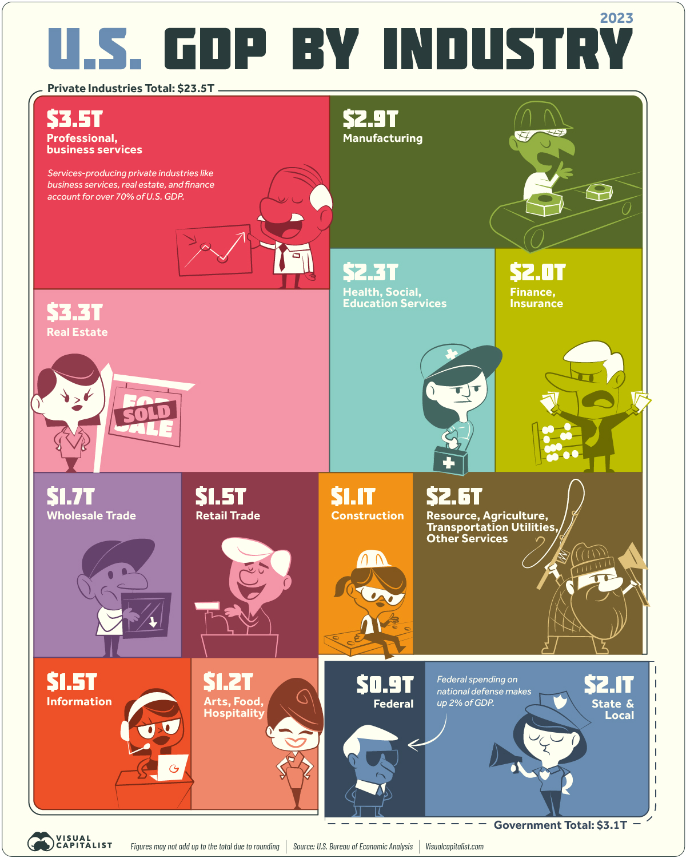
Different Breakdown
Note: State and Local Government comprises 10% of GDP!

Slide 19
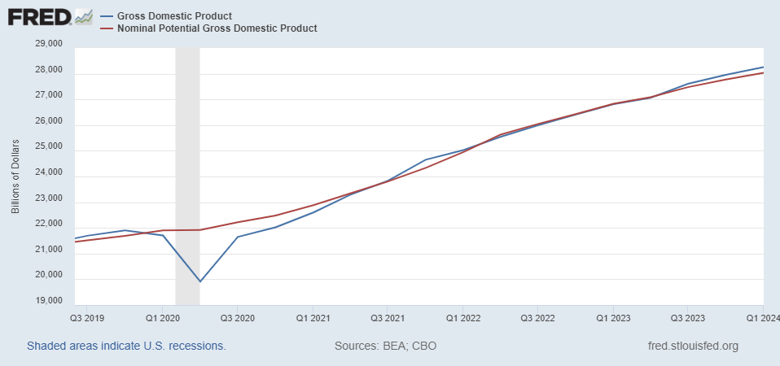
GDP and ‘Potential’ during the Recovery
Grey bar indicates recessions
Source: Fred, St Louis Fed

Slide 20
What is a Recession?
Defined by the National Bureau of Economic Research (NBER)
“The NBER's definition emphasizes that a recession involves a significant decline in economic activity that is spread across the economy and lasts more than a few months.”
Popular Rule of Thumb: Two or more, consecutive quarters where Real GDP falls. (Doesn’t always work!)
Recessions are caused by a drop in total spending.

Slide 21
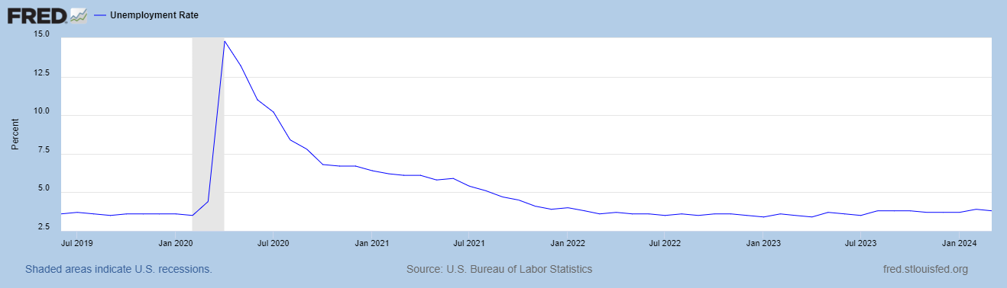
Unemployment is Near Record Lows

Slide 22
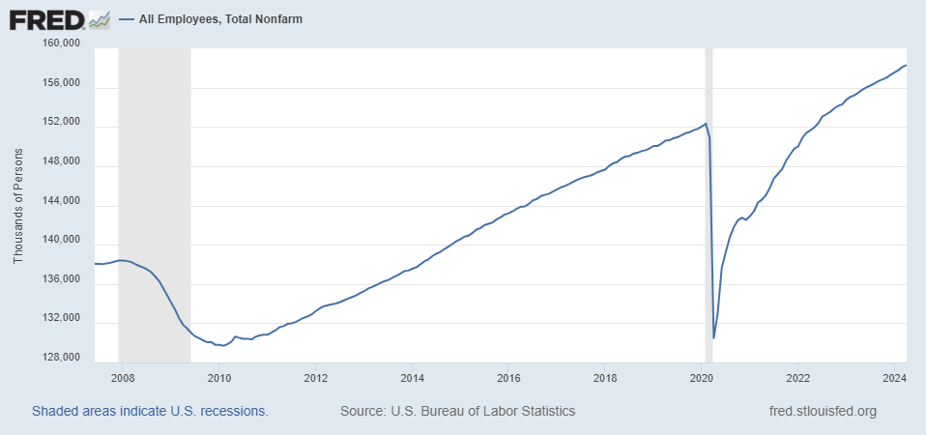
Where Have All the Workers Gone?
Notes:
Largely explained by baby boomer retirements and a little excess retirements due to COVID

Slide 23
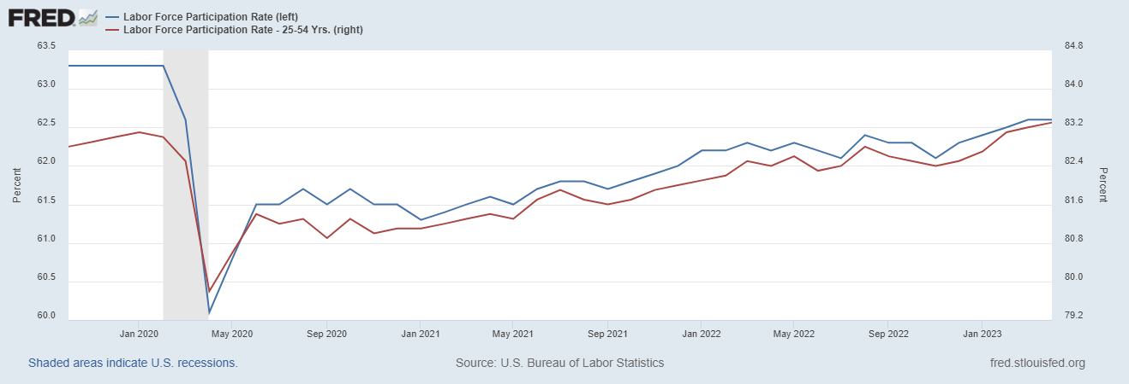
The Aging of the Labor Force

Slide 24
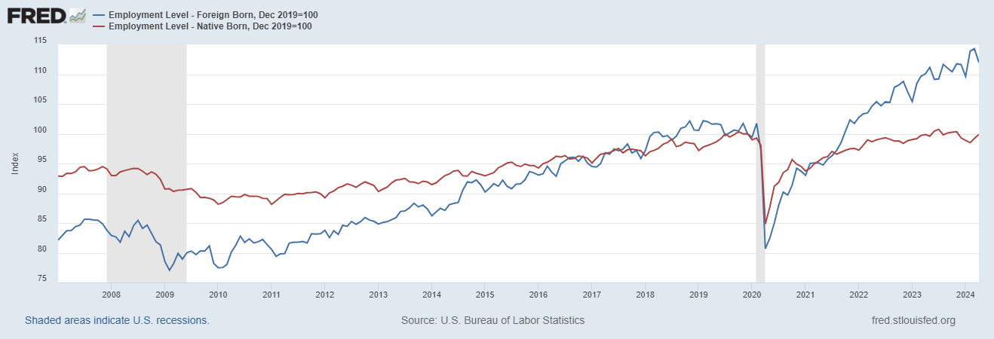
Supplemented by Foreign Workers

Slide 25
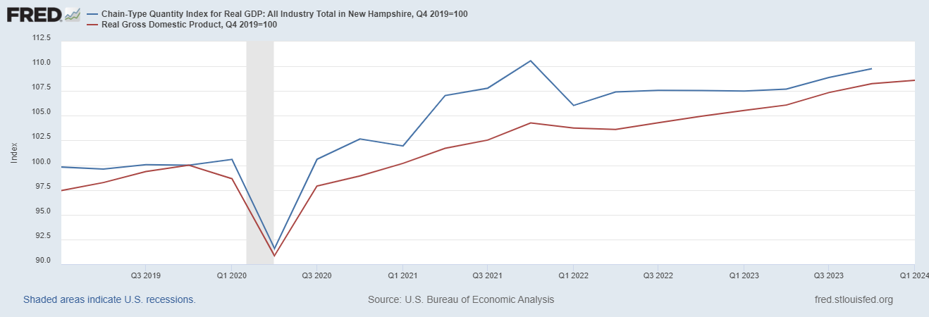
How is New Hampshire Doing?

Slide 26
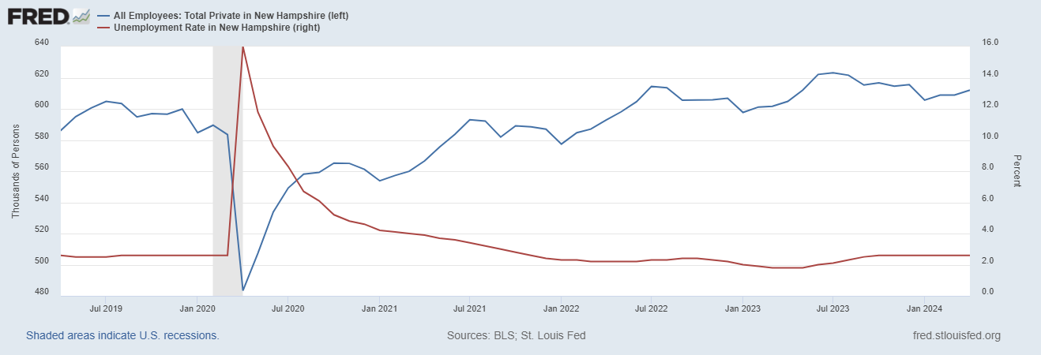
Labor Market in New Hampshire
Notes:
REI about 1% increase in employment vs. 4.3

Slide 27
Overall Good News on the Real Side
GDP is very close to its potential.
The labor market as measured by the unemployment rate is fully recovered.
There was no apparent Great Resignation
But there is also a nominal side: interest rates, asset prices, inflation and wages.
News isn’t so good, but is getting better.

Slide 28
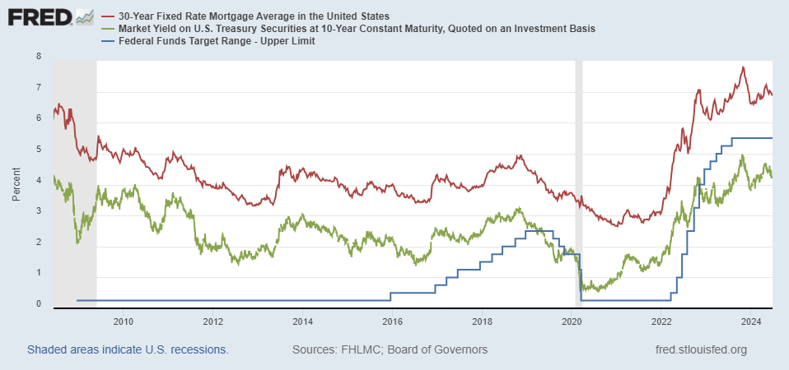
Interest Rates: Era of Falling Rates Over?
Notes:
Fed policy rate 4.5 to 4.25. Concerns with inflation

Slide 29
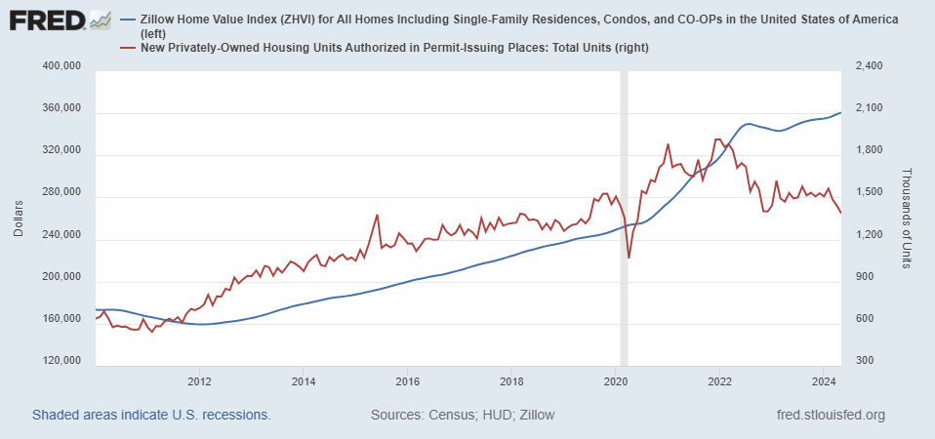
Mortgage Rates are Having an Effect ?

Slide 30
National Housing Market and Closer to Home
https://www.zillow.com/research/data/

Slide 31
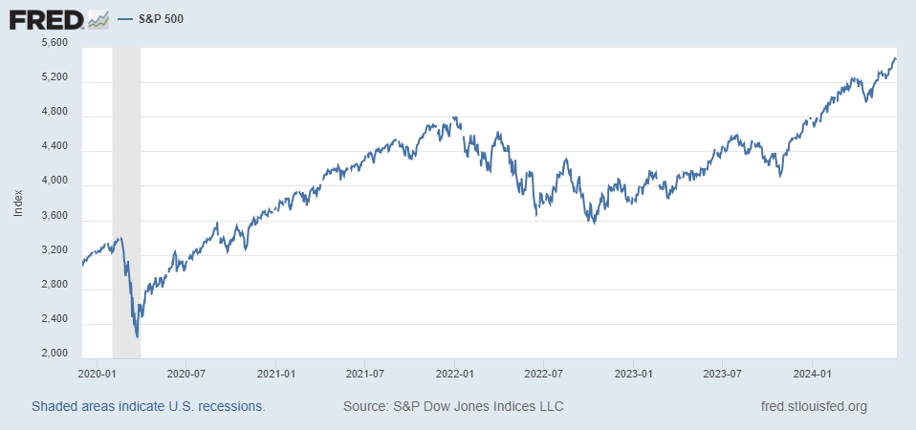
Stock Prices: Fear Giving Way to Greed?
Notes:
Since the end of 2021, lost almost 15%

Slide 32
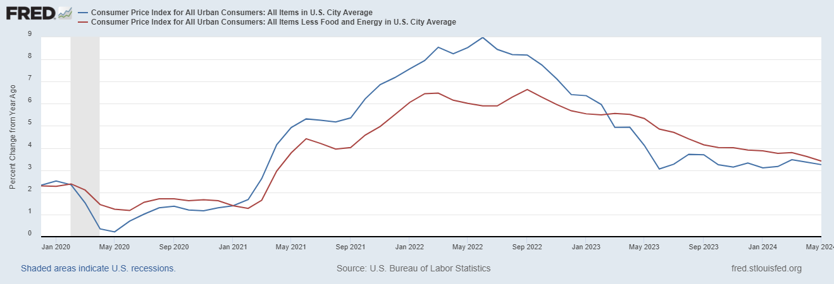
Inflation during the Recovery (CPI)
Notes:
August CPI yoy 8.3% down from 8.5 and Core 6.3 up from 6.3 in JUly

Slide 33
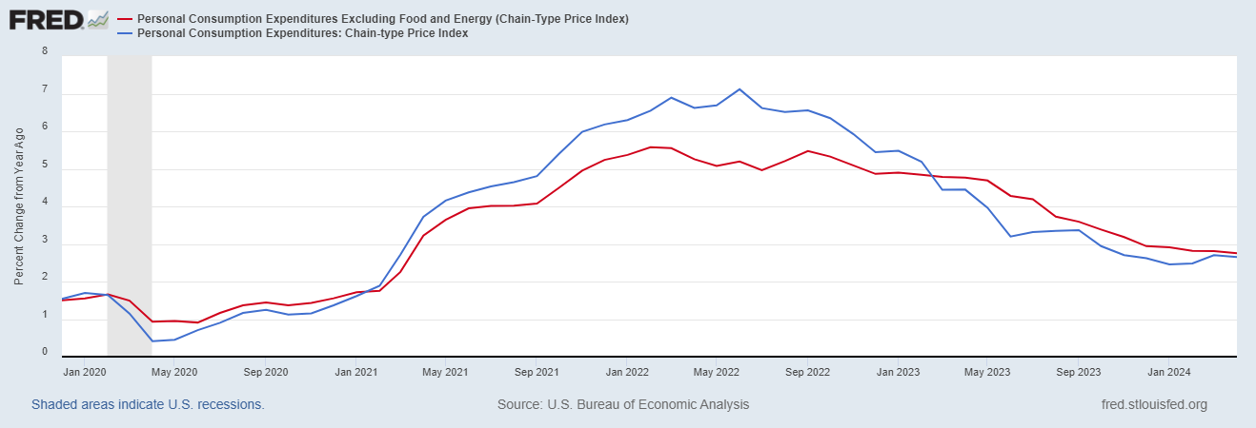
Fed’s Measure (PCE)
Inflation Accelerates 3/2021
Fed Doesn’t React until 3/2022
Looks Worrying?

Slide 34
CPI vs. PCE: Differences
CPI tends typically to be 0.3 pct point higher
April:
CPI, 3.4% PCE, 2.7%
Core CPI, 3.6% Core PCE, 2.8%.
https://www.businessinsider.com/pce-vs-cpi-weight-comparisons-2014-6

Slide 35
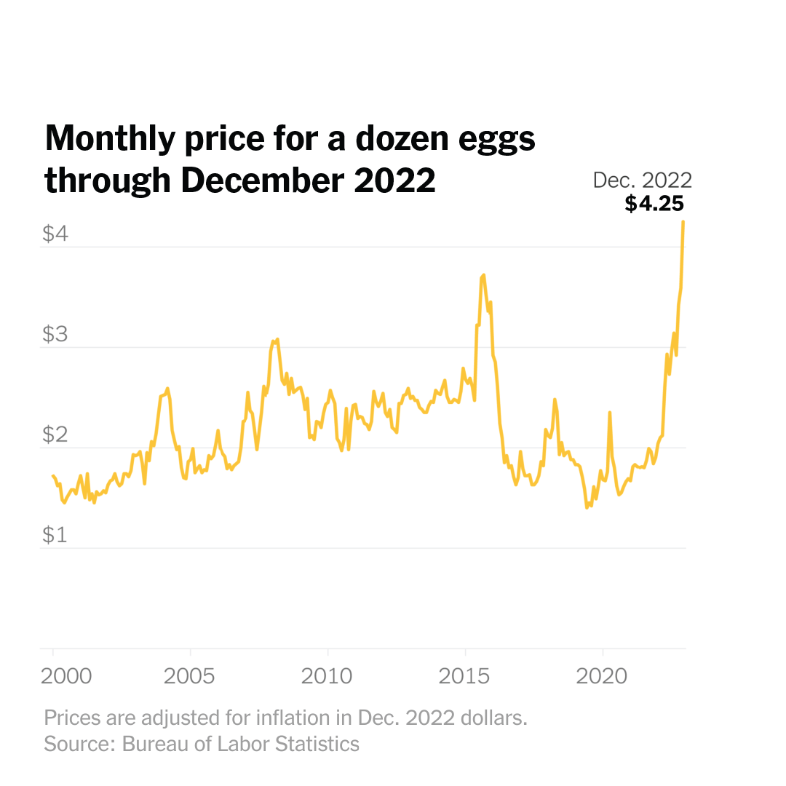
Uses of Inflation Measures
Two Reasons for Measuring Recent Inflation:
What has happened to the Cost of Living?
What is likely to happen to inflation over the next 12-18 months?

Slide 36
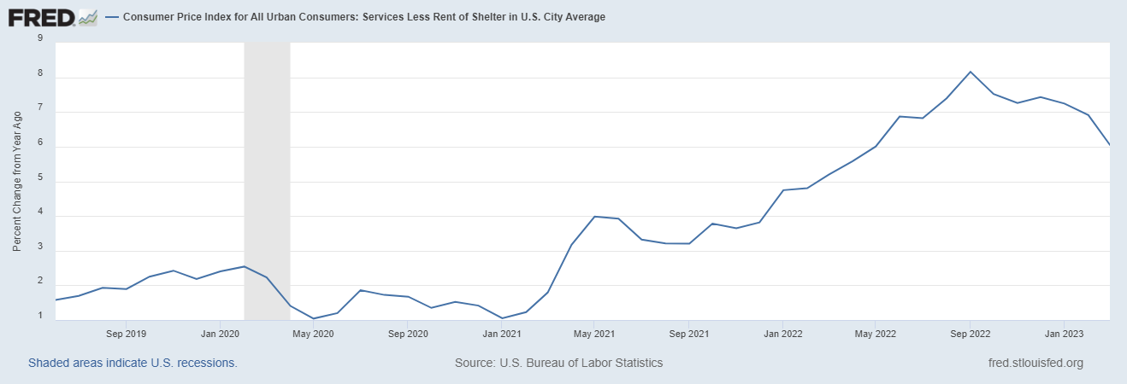
Measuring “Underlying” Inflation
Super Core!

Slide 37
The Importance & Problems with Rents
Notes:
Shelter is 36% of CPI and 45% of Core CPI. About half as much in PCE. CPI less shelter is 2.3% sine March of last year. Shelter is up 5.8%

Slide 38
Wages Haven’t Kept Pace with Inflation, Yet
Federal Reserve of Atlanta, “Wage Tracker” and BLS
Notes:
But, note that low wage workers are doing relatively the best

Slide 39
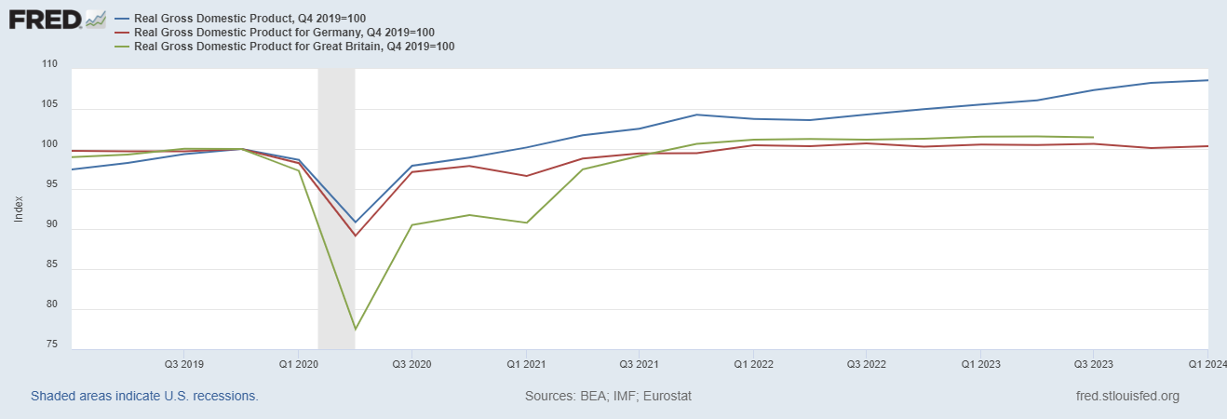
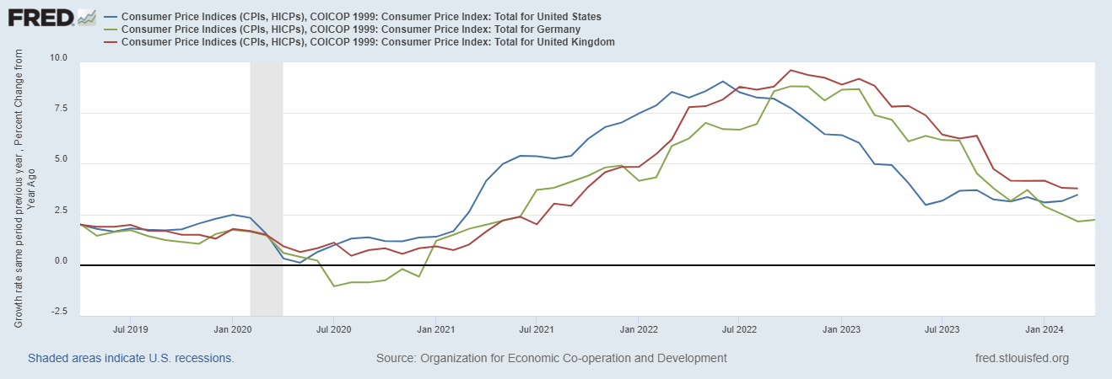
International Comparisons

Slide 40
The “Nominal” Side
Inflation: A lot of progress on inflation, but the recent data are troubling.
But, this is not the popular view

Slide 41
Five Minute Break!
Take 5!

Slide 42
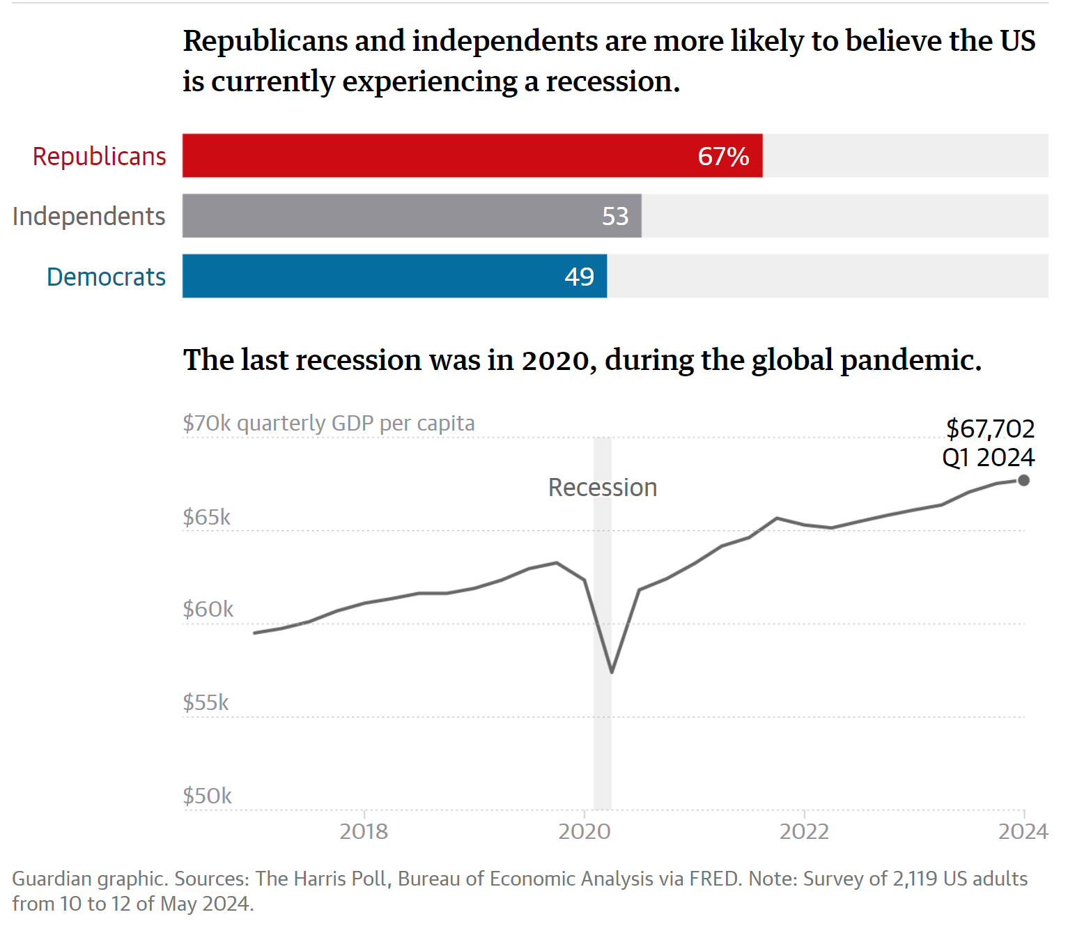
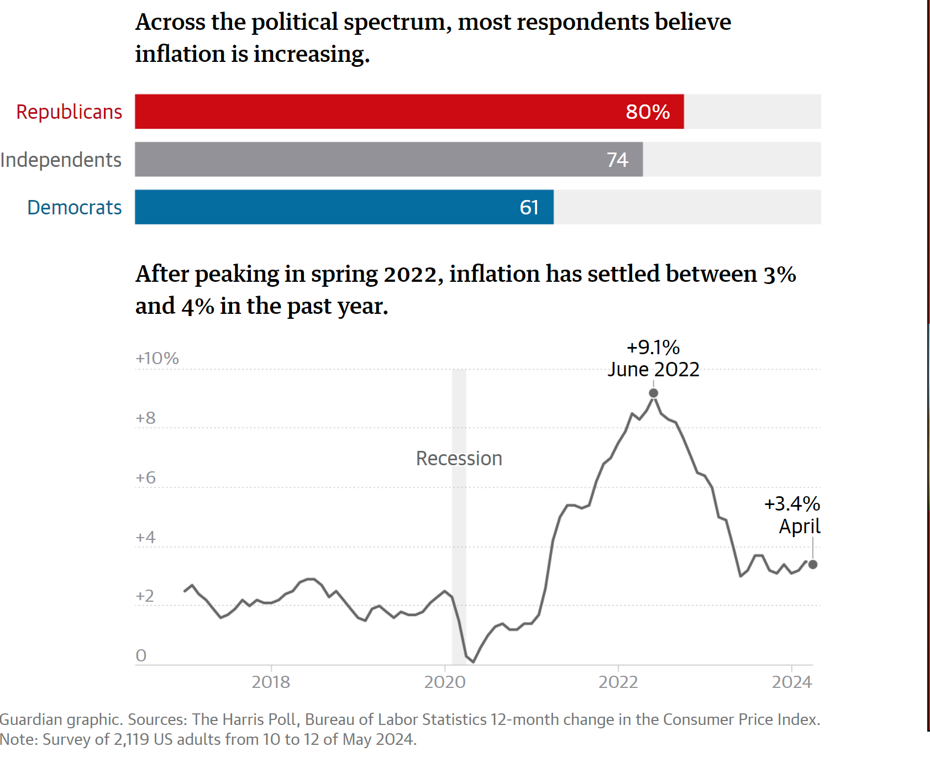
Why We Give These Lectures
https://www.theguardian.com/us-news/article/2024/may/22/poll-economy-recession-biden
Notes:
49% believe Stock Market is down, and unemployment is at a 50 year high

Slide 43
High Prices versus Inflation

Slide 44
Housing Prices Vs Inflation

Slide 45
Wages vs Prices and Inflation

Slide 46
Housing Again!
Bolhuis, Cramer, Schulz & Summer, The Cost of Money is Part of the Cost of Living
https://www.nber.org/papers/w32163

Slide 47
Policy Effects
Stabilization policies aim to affect the level of total spending or “aggregate demand.”
Fiscal Policies of increasing spending and/or cutting taxes can raise total spending. (Congress and the President)
Monetary Policy affects total spending via interest rates: lower interest rates leads to more spending (the Fed)
Except in deep recessions, the Fed has primary responsibility for stabilization policies.

Slide 48
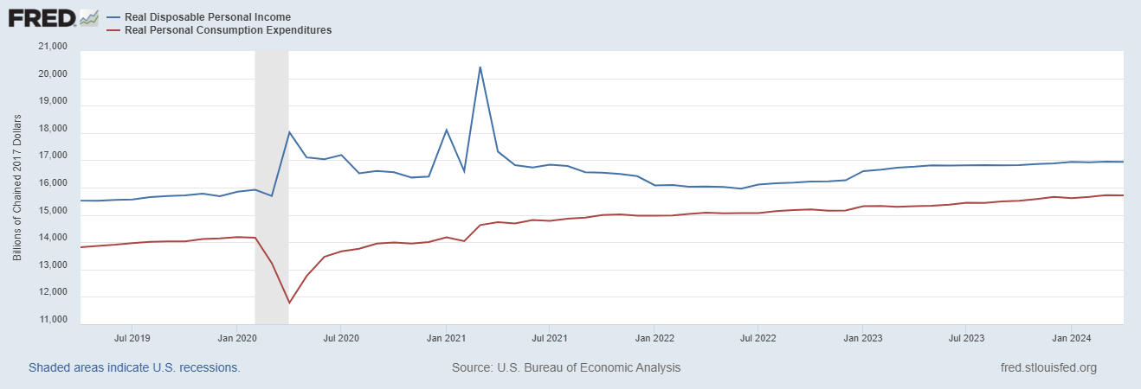
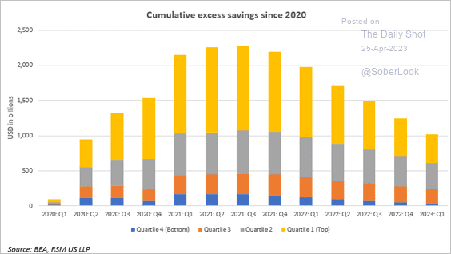
Policy Effects: Fiscal
2020-2021: massive stimulus, $4.6t: Cares Act, 3 rounds of stimulus checks, expanded unemployment benefits, Payroll Protection Loans.

Slide 49
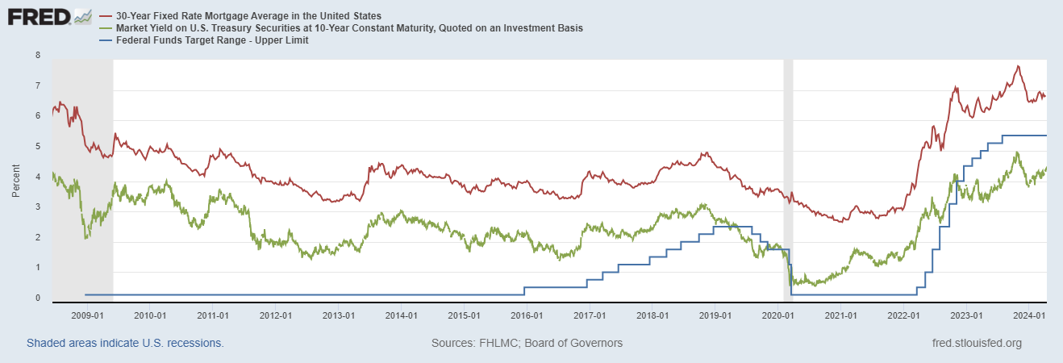
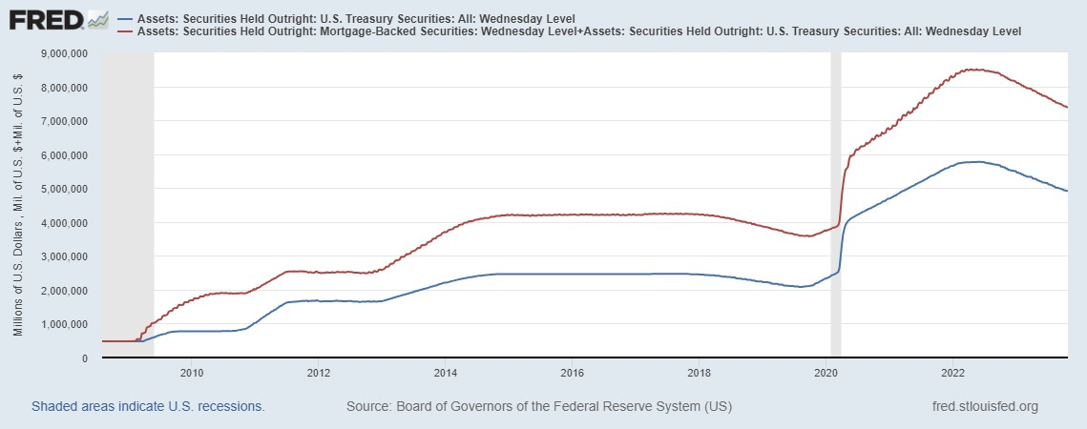
Policy Effects: Monetary
2020-2/2022: short term policy interest rate at zero, new round of quantitative easing.
3/2022-present: most rapid increase in interest rates since Paul Volcker

Slide 50
About Face at the Fed in 2022
1/26: Supply and demand imbalances related to the pandemic and the reopening of the economy have continued to contribute to elevated levels of inflation. (inflation 7.6%)
3/16: Inflation remains elevated, reflecting supply and demand imbalances related to the pandemic, higher energy prices, and broader price pressures (emphasis added). (8.5%)
6/15: The Committee is strongly committed to returning inflation to its 2 percent objective. (9.0%)

Slide 51
Fed’s View on the Economy
June 2024
Austin Goolsbee, President of the Chicago Fed, The economy is on a “golden path” and will achieve the “mother of all soft landings.”
How did this happen?

Slide 52
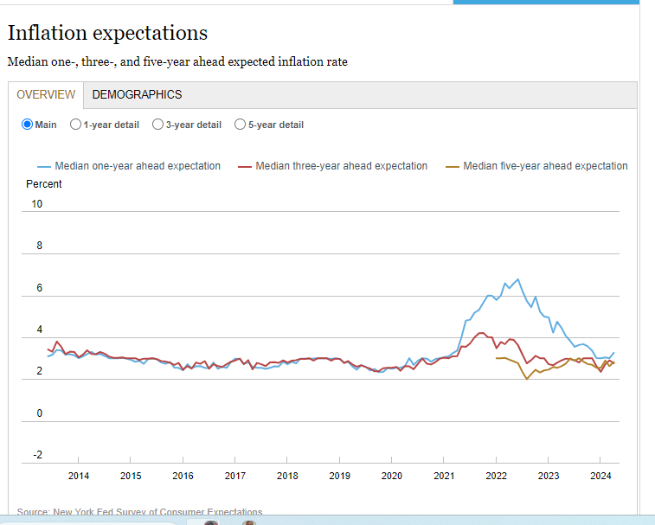
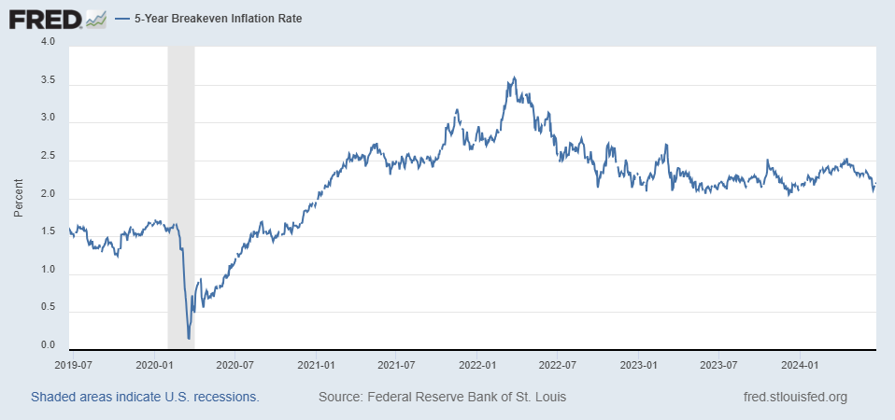
Long-Term Inflation Expectations Remained “Well Anchored”

Slide 53
Assessing Credit and Blame (my views)
Congress and the President: Fiscal Stimulus prevented deep world-wide recession. American Rescue Plan probably too big.
The Fed. Major blame for being late in reacting to increase in inflation. Since 3/22, so far so good. Verdict is out: good policy or good luck?

Slide 54
Spring Inflation Jitters

Slide 55
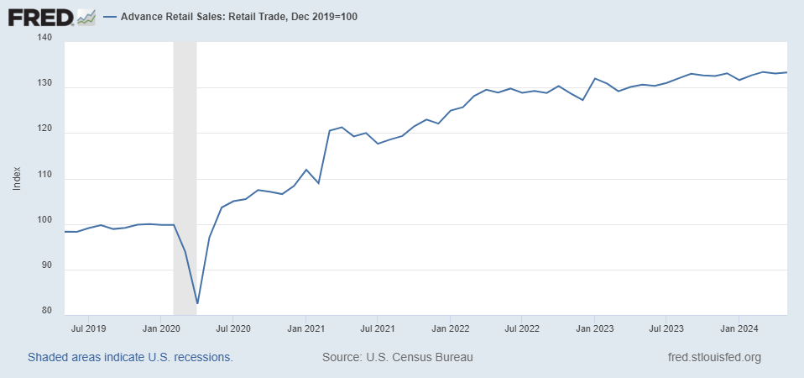
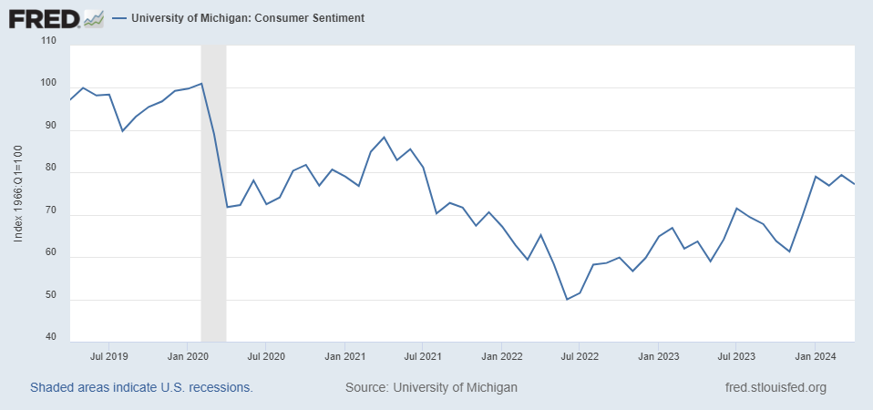
The Nervous Consumers?

Slide 56
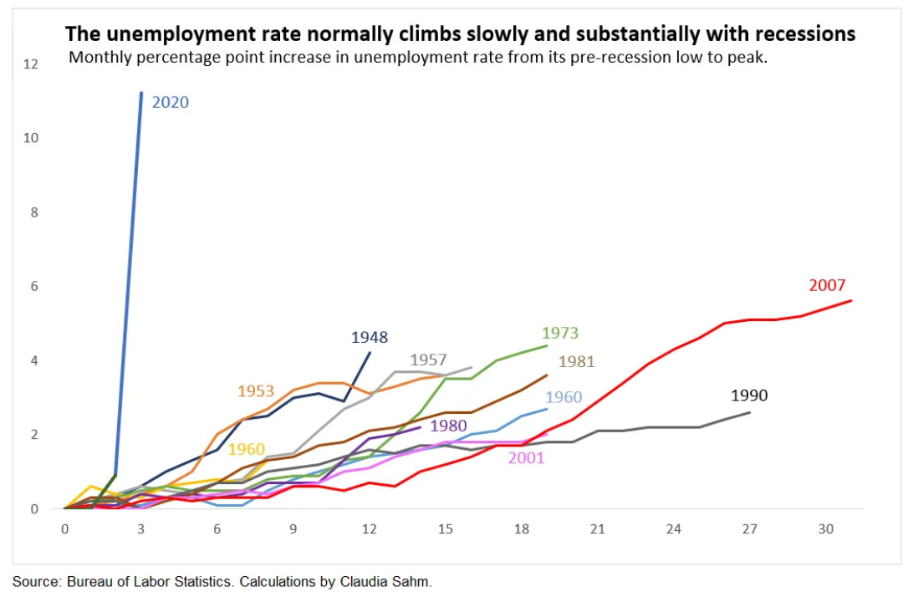
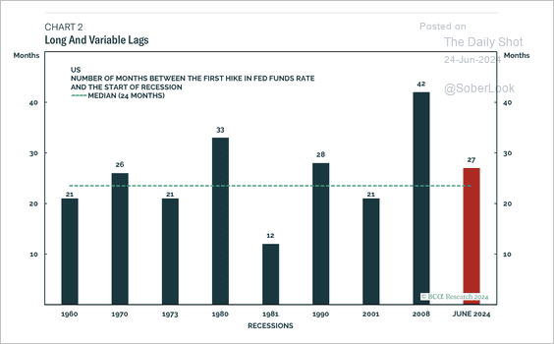
Nervous Fed? (Given Past History)
https://www.bcaresearch.com/macro-research-services

Slide 57
What will the Fed Do?
Pending Developments:
Consumption (2/3rds of GDP) appears to be slowing.
Progress on inflation still is in some doubt.
New Data: Unemployment first Friday of the month; PCE inflation, 6/28, 7/26.
Two more FOMC meetings before the election: July 30-31 and September 17-18.
(followed by a meeting Nov. 6 -7!)
Politically Charged Environment!
Notes:
GDPNow 2.4%; blue chips consensus 1.5% implies 2.9%, or 2.7%

Slide 58
Interest Rate Cuts?
https://sites.google.com/view/macro-current-issues/home

Slide 59
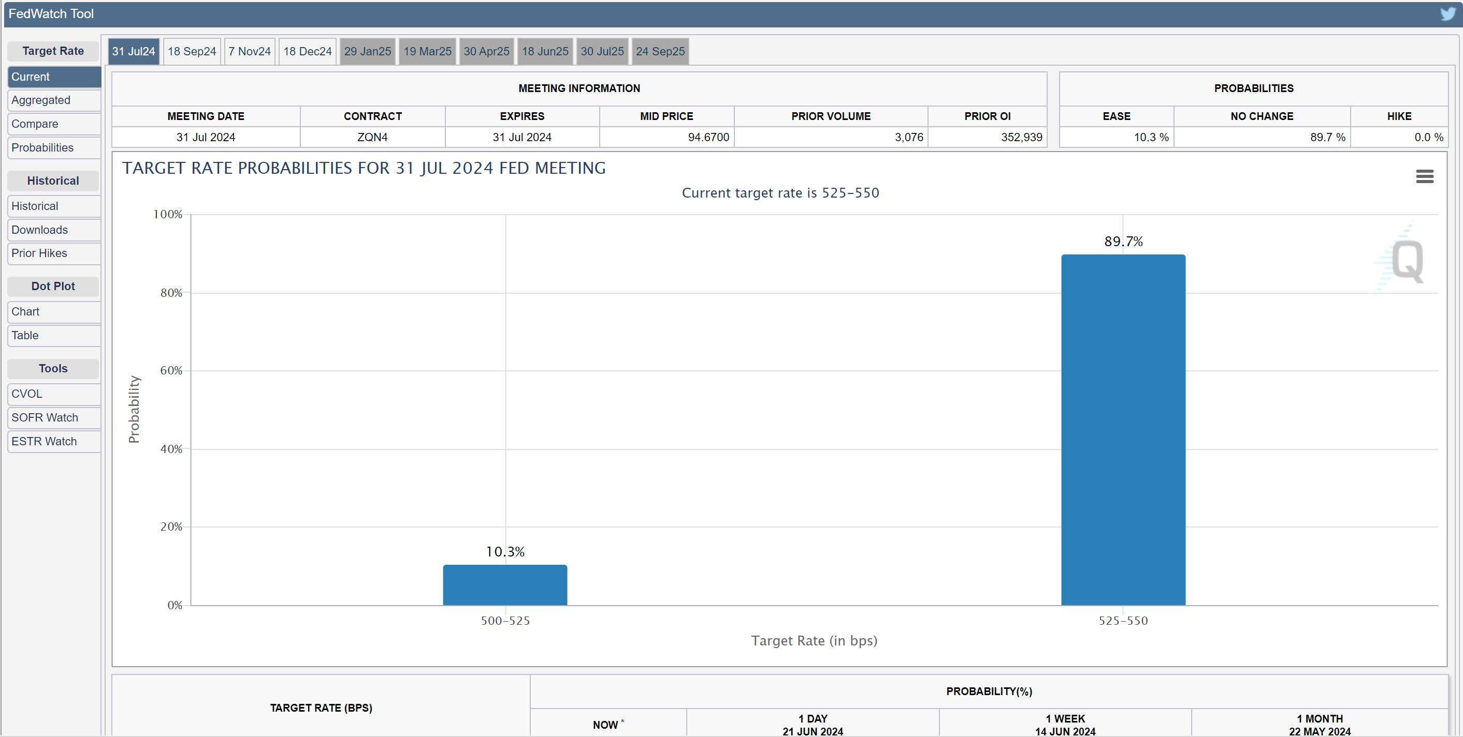
Interest Rate Cuts?
https://www.cmegroup.com/markets/interest-rates/cme-fedwatch-tool.html

Slide 60
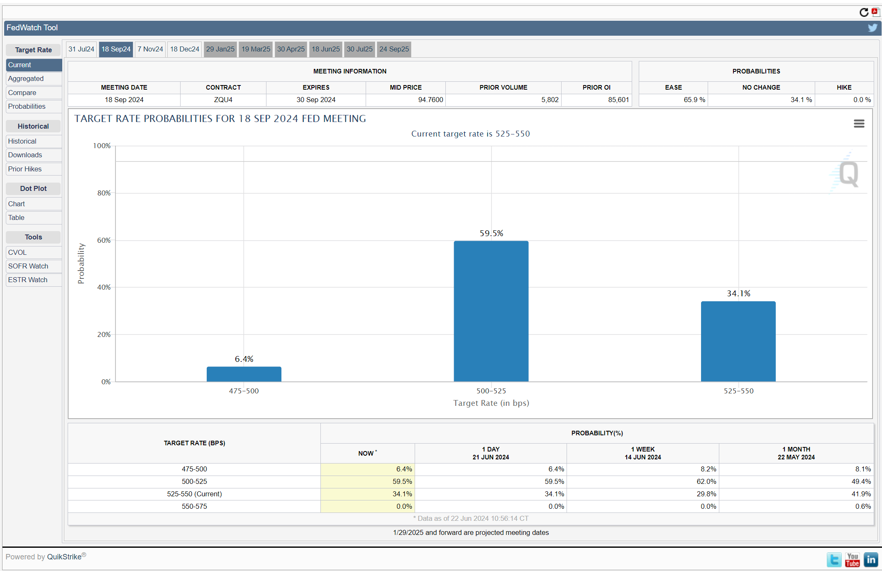
The Action is in September

Slide 61
Main Economic Institutions
Notes:
https://sbhshgovapmacro.wordpress.com/2011/06/02/international-institutions/

Slide 62
Let’s Hear from You!
Geoffrey Woglom grwoglom@amherst.edu
Contact NEED: Info@NEEDEcon.org
Support NEED: www.NEEDEcon.org/donate.php

